Slide 1

Application: Bargain Hunter Type: Application Architecture View: Logical View Style: Layered Architecture Pattern
Users
Delivery Channels
Core Business Processes
Data And Information
Technology Enablers
Property Listing/Post Ads
User Profiles
Database
Students
User Inquiries
Account/subscription details
Connection for Database (MySQL, MongoDB,
Firebase, Java(Spring))
Account/subscription Management
Transaction records
Working Professionals
Browser (Web Application)
Payment processing
Inquiry History
Location API (Google API)
Customer Support
Customer Query Details
User Interface (HTML, CSS, React)
Advertising Management
Performance metrics
Property Owners/Landlords
Application Hosting Server (AWS Elastic)
Location services
Images of products/properties
Availability Status
User Feedback
GitHub & Delivery Pipeline(Jenkins)
Sellers

Slide 2
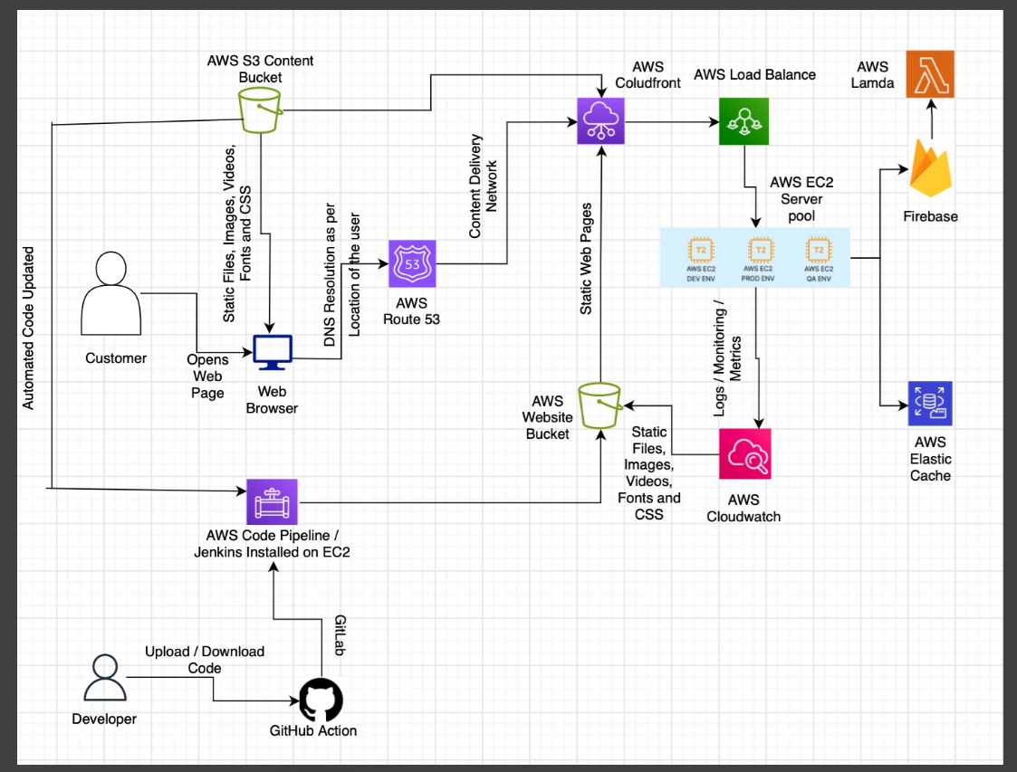
Application: Bargain Hunter Type: Application Architecture View: Process View Style: Client-Server Pattern

